Slide 1

Face mask detection
Faculty of Information Technology
The Egyptian E-Learning University (EELU)
Graduation Project
2023-2024

Slide 2
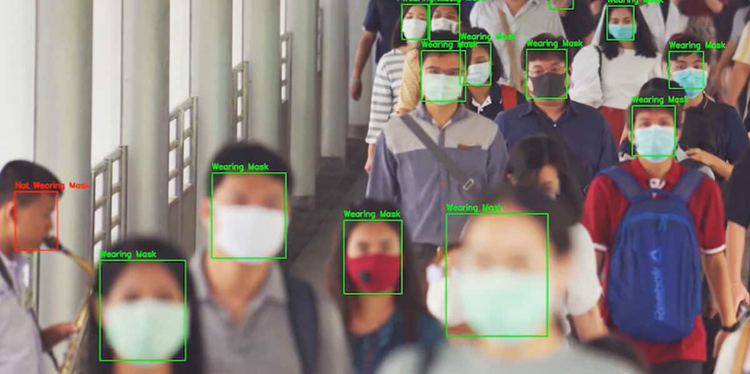
Presented by:
Taher Abdelazim Fayez - 2001364
Moatasem Mohamed Sadek - 1901304
Fady Ehab Youssef - 2000505
Ahmed Mohamed Abdellatif - 2001420
Sara Fahmy Ahmed - 2000175
Abdelrahman Galal Mohamed - 2000101
Kermina Nabil Henen - 2000156
Supervised by:
Dr. Hanaa Bauomy
Eng. Doaa Mahmoud Hassan

Slide 3
Agenda
01
Introduction
04
Implementation &
proposed method
02
Background
05
Conclusion
Future work
03
06
Demo
Related work

Slide 4
Introduction

Slide 5
1 - Introduction
Probably because of the sudden emergence of the COVID-19 pandemic, at present, there are various facial recognition technology applied to people wearing masks. Detection of face masks is an extremely challenging task for the face detectors. This is because faces with masks have varied accommodations, various degrees of obstructions, and diversified mask types. Face Mask detection models have many variations. These can be divided into several categories like Boosting-based classification
Benefits of the proposed model:
Spreading awareness of prevention among people through the mask
Make people more confident about their health
Helping hospitals and public facilities establish more stringent laws regarding wearing mask
This system will help limit the spread of any infectious diseases
Providing more protection for children and the elderly, who are more vulnerable to infection

Slide 6
BackGround

Slide 7
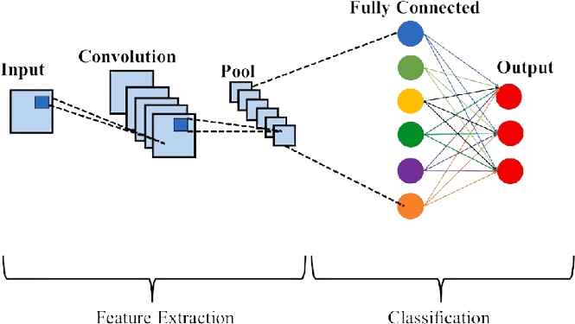
2 - BackGround
1 - Convolution Neural Network ( CNN )
Is a type of deep learning models used usually to analyze visual data it consist of many layers that can learn and extract features from input images effectively and it contain convolution layers and pooling layers and fully connected layers we use it in our project because it can effectively identify patterns in images such mask or not .

Slide 8
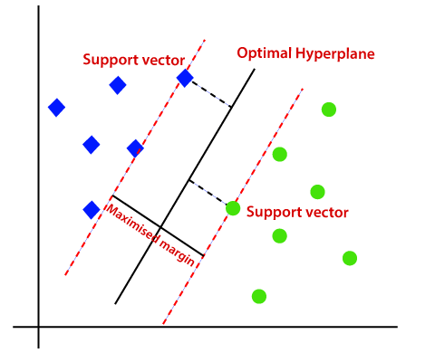
2 - BackGround
2 - Support Vector Machine (SVM)
is a type of supervised machine learning model used for classification and regression tasks we use SVM model because there is non-linearity relationship in data image SVM can actually deal with that with using kernel that can deal with it that if the face wearing mask or not and SVM so good for images that has pixel value.

Slide 9
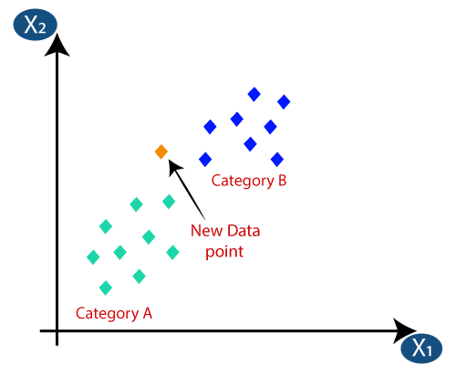
2 - BackGround
3 - K-Nearest Neighbours(KNN)
is a type of supervised machine learning model used for classification and regression tasks KNN is a simple algorithm that provide simplicity just depend on the number of K-Neighbor that are nearer to the point to identify it what is it from three categories so it’s easy in implementation addition to that it’s easy to change between dataset as it is a non-parametric algorithm and it handle non-linear relations

Slide 10
Related Work

Slide 11
3 - Related work
Paper | Dataset | Size | Models & Accuracy | Limitation
Deep Neural Architecture for Face mask Detection on Simulated Masked Face Dataset against Covid-19 Pandemic (19 February 2021) | SMFD (two classes) | 1315 images (658 mask and 657 without mask) | CNN:97% | Images is not enough Only 2 classes
COVID-19 Face Mask Detection Using CNN and Transfer Learning (28 February 2022) | Face Mask Detection Dataset (for 2 classes, with and without ) | 7553 images 3725 and images of faces without masks are 3828. | CNN:97% | The quality of the images is inappropriate and not clear Only 2 classes

Slide 12
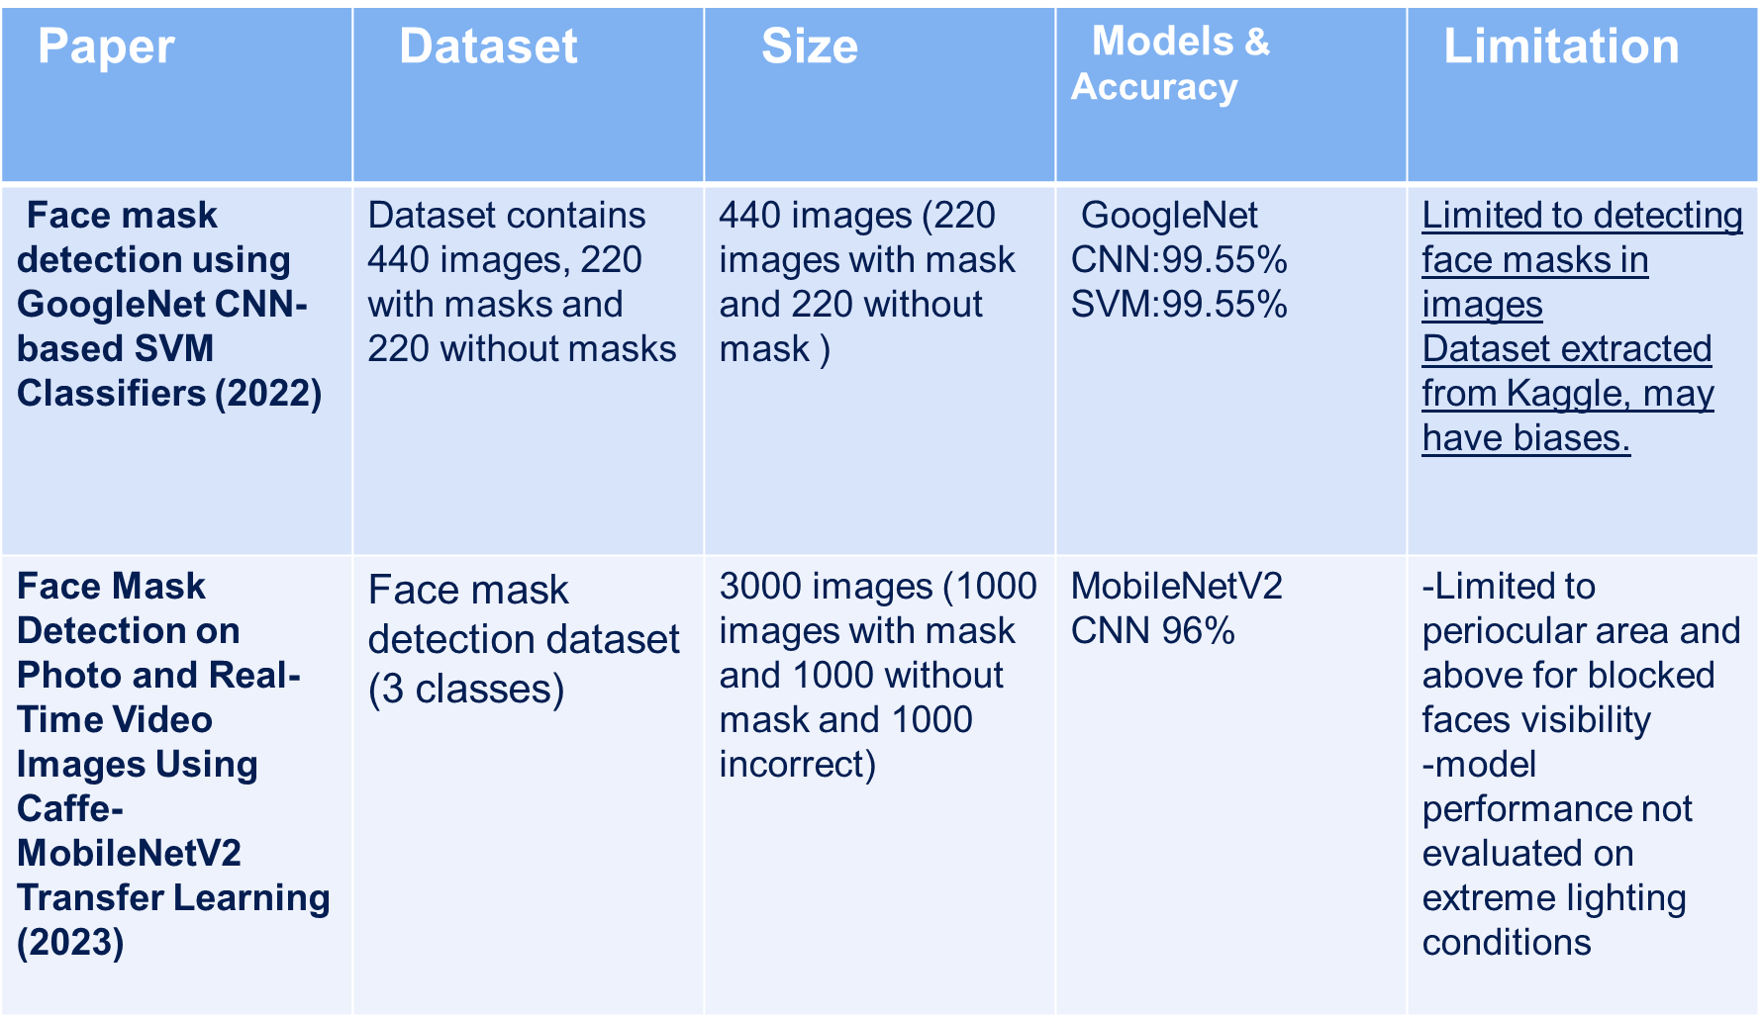
3 - Related work

Slide 13
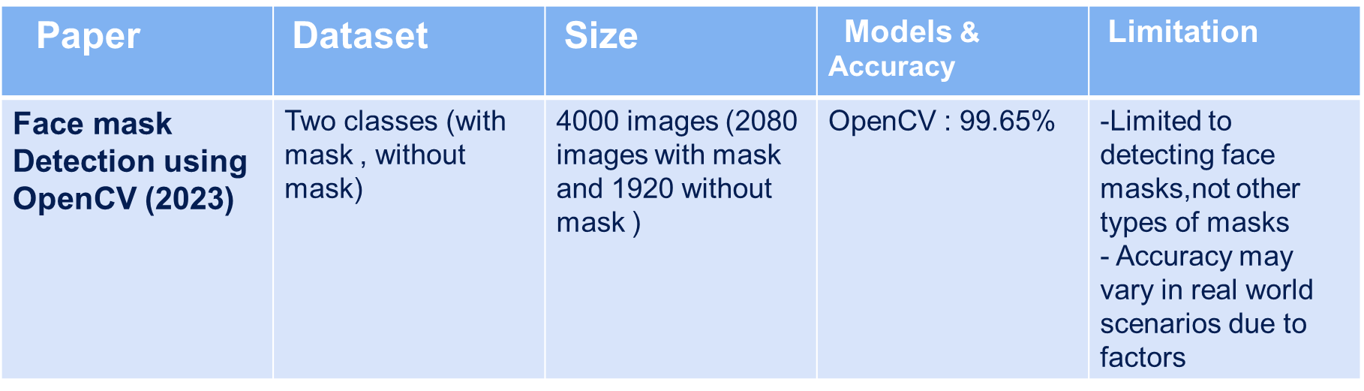
3 - Related work
Finally we use Face Mask Detection on photo and RealTime Video Images

Slide 14
Implementation And Proposed Methods

Slide 15
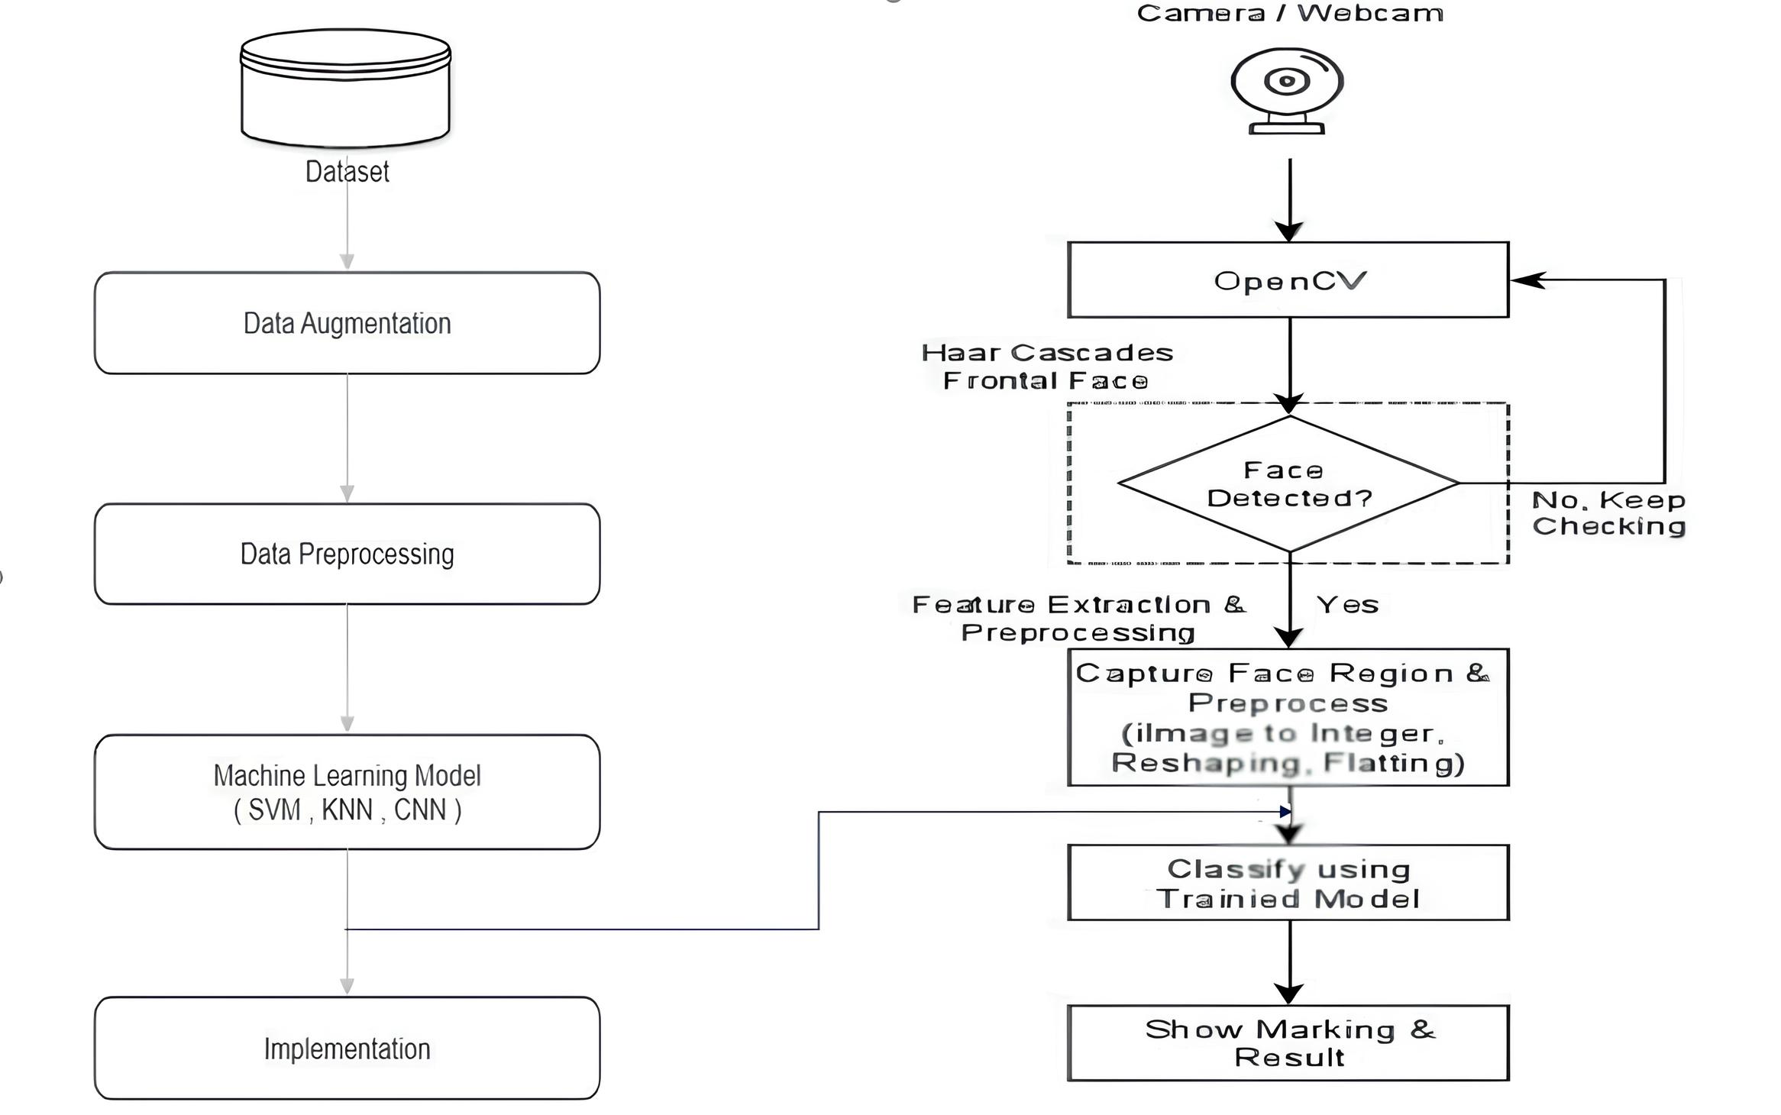
- Proposel Frame work
Dataset
Data Augmentation
TensorFlow/Keras
Data Preprocessing
Capture Face Region& Preprocess
(Image to integer, Reshaping, Flatting).
Machine Learning Model
(SVM, KNN , CNN)
Implementation

Slide 16
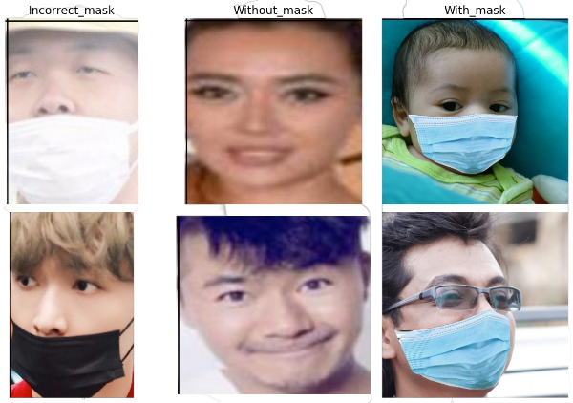
- Dataset Selection
Let’s talk about data we use data with the name Face Mask Detection On Photo And Real Time Video By Vijay Kumar from Kaggle, The number of images in this dataset are 3000 images with and the size of them is 488 MG and split into 3 categories with mask , without , incorrect the format of images include jpg and png and we make the resolution of this data 150 × 150 and the images in RGB format .
( Reference Data : Kaggle)

Slide 17
- Data Augmentation
Because of our data is small and training in it will lead to underfitting we make this step for duplicate our data and taking in consideration to not make it overfitting suit our data in reasonable way and predict correctly any pictures that is not in our data, and we apply it for these steps we achieve generalization
rotate our data with 40 degree
shift images horizontally up to 20% in width
shift our images vertically up to 20% in height
shear our images to 20% and that's means we stretch our images, and this helps model to learn features
applying zoom in and out to images
horizontal flipping help the model to learn features more
we apply after that fill mode :- Nearest this mean that after we apply some transformations in our dataset this will lead to find empty pixels fill mode nearest fill these empty pixels with the colour of nearest pixel before transformation

Slide 18


- Result Of Augmentation
Before
After
1000
15000
WithMask
1000
15000
Wthout Mask
1000
15000
Incorrect Mask

Slide 19
- Data Preprocessing
In this step we make our data fit as closely as possible to suit the Model In training Process and we use :-
Normalization :-
In this step we make Feature Scaling to our image That make pixel in our image takes common range That Can improve performance our model And make it faster in training
Reshaping :-
In this step Reshaping our pictures to make it around 150 × 150 or between 64 × 64 that because of not making our training process spend a lot of time compared to original one
Data Splitting :-
After this last step is to split our data to training and testing we make it 0.8 training and 0.2 testing to make our model can learn pattern and features in good manner

Slide 20
- Results Models
Support Vector Machine :-
Test Accuracy with mask : 91.00%
Test Accuracy without Mask : 93.67%
Test Accuracy Incorrect : 95.00%
K-nearest Neighbor :-
Test Accuracy with mask : 75.33%%
Test Accuracy without Mask : 84.83%
Test Accuracy Incorrect : 77.67%
Convolution Neural Network :-
Training Accuracy : 92.22%%
Validation Accuracy : 96.70%
Test Accuracy : 96.70%

Slide 21




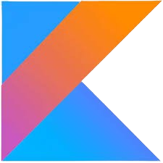
- Tools Are Used
1
2
3
4
5
Kotlin
Tenserflow
Python
Android St
Teachable Machine
The programming language used for developing the Android app.
Used for running machine learning models on-device.
Programming language used to develop and train the machine learning model.
is an IDE specifically designed for developing Android applications.
Used For integration

Slide 22
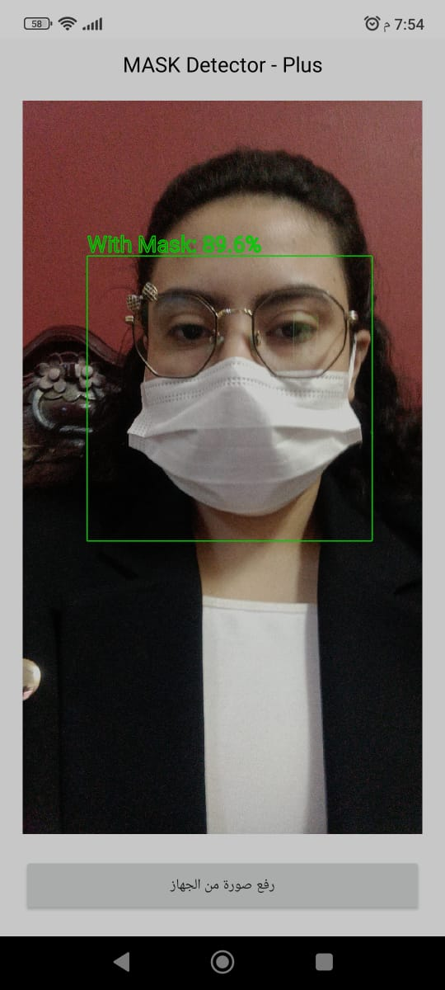
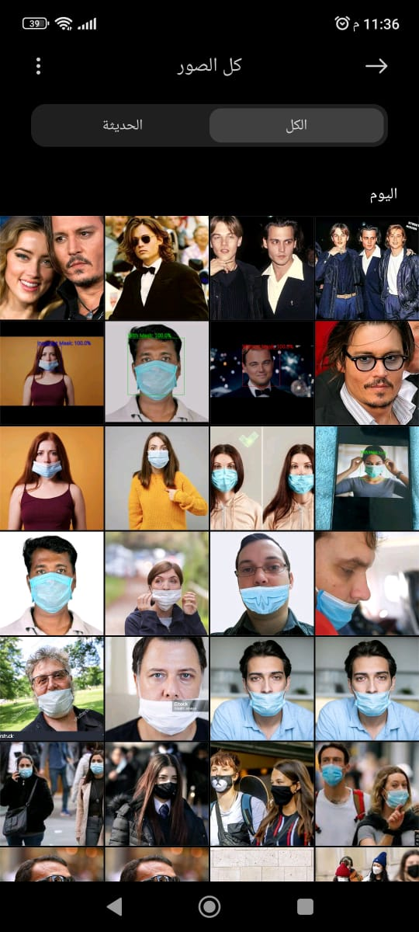
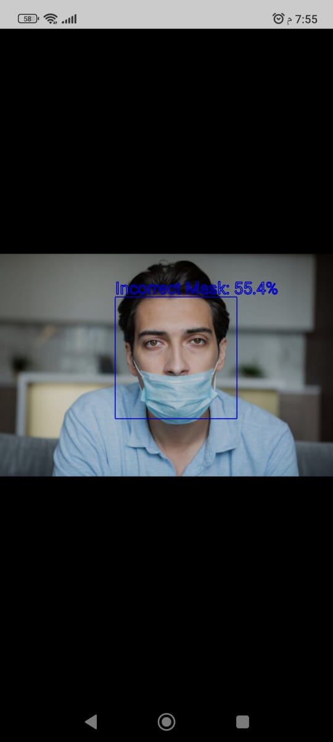
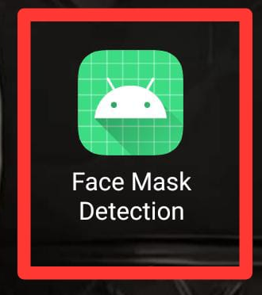
- GUI
App Icon
Camera View
From Gallery
Image Selected

Slide 23
Conclusion Future Work

Slide 24
- Conclusion and Future Work
Conclusion
- This pandemic has wreaked havoc on the entire world, and the world is now facing a massive health crisis as a result of the deadly disease that was declared by WHO in 2020, and governments and organizations struggled to control it before WHO issued preventive measures such as hand sanitizer, hand washing, and social distance This model was created using CNN and image augmentation techniques were employed to improve the model’s performance in this study The proposed method uses the SVM And KNN as an image classification algorithm that can detect whether an image contains a picture of people wearing or not wearing a face mask.

Slide 25
- Conclusion and Future Work
Future Work :-
combine between models :Instead of relying on just one model (CNN, KNN, or SVM), you could combine their predictions using ensemble methods. Imagine your app asks each model if someone is wearing a mask, then takes a majority vote (most models agree) for the final answer. This can potentially make your app more accurate and reliable.
User distance of camera: Developing the application so that it can take pictures from any possible distance and capture more than one person at the same time.
Data size: Increase the size of the data instead of adding and repeating it to make it balanced with the increase accuracy and more generalization .
Image quality and time saving Make preprocessing taking less time for the trained model to save more time and give high accuracy

Slide 26
Demo

Slide 27
- Demo

Slide 28
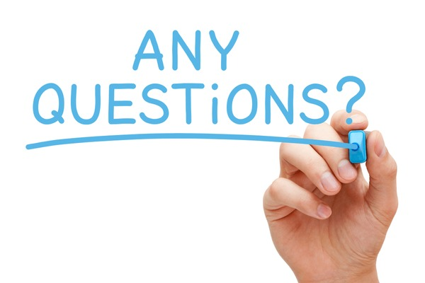

Slide 29


